Slide 1
Bank Loan Case Study
Exploratory Data Analysis (EDA) for Identifying Loan Default Patterns

Slide 2
Project Description
The project aims to analyze loan application data to identify patterns that indicate potential payment difficulties. The goal is to help the company make informed decisions regarding loan approvals, reducing financial risks and ensuring capable applicants are not rejected.
In other words, the company wants to understand the driving factors behind loan default, i.e., the variables which are strong indicators of default.

Slide 3
Business Objective
The main aim of this project is to identify patterns that indicate if a customer will have difficulty paying their installments. This information can be used to make decisions such as denying the loan, reducing the amount of loan, or lending at a higher interest rate to risky applicants. The company wants to understand the key factors behind loan default so it can make better decisions about loan approval.

Slide 4
Tech Stack Used
Tools Used:
Microsoft Excel Home and Student 2021: Used for Data Cleaning, Data Analysis and visualization.
Microsoft PowerPoint: Used for Reporting and Presentation

Slide 5
Approach
Acquiring Data and Familiarization (Data Provided by trainity).
Data Cleaning using Microsoft Excel
Data Analysis using Microsoft Excel
Data Visualization in Microsoft Excel
Reporting and Presentation

Slide 6
Tasks
Missing Data Handling: Identify and handle missing data using Excel functions like COUNT, ISBLANK, and IF. Consider imputation with AVERAGE or MEDIAN. Visualize with bar or column charts.
Outlier Detection: Use QUARTILE and IQR in Excel to detect outliers. Highlight them with conditional formatting. Visualize using box plots or scatter plots.
Data Imbalance Analysis: Evaluate data imbalance using COUNTIF and SUM. Calculate class ratios and visualize with pie or bar charts.
Variable Analysis: Perform univariate, segmented univariate, and bivariate analyses using Excel. Use functions and pivot tables to explore distributions and relationships. Visualize with histograms, bar charts, or scatter plots.
Top Correlations Identification: Identify top correlations in segmented data using CORREL. Visualize with correlation matrices or heatmaps, highlighting key indicators.

Slide 7
Identify Missing Data and Deal with it Appropriately
As a data analyst, you come across missing data in the loan application dataset. It is essential to handle missing data effectively to ensure the accuracy of the analysis.
My Task: Identify the missing data in the dataset and decide on an appropriate method to deal with it using Excel built-in functions and features. Create a bar chart or column chart to visualize the proportion of missing values for each variable.
Click here for Excel file

Slide 8
Proportion of Missing Values: Identified the percentage of missing values for each column.
Columns with High Missing Values: Columns with more than 50% missing values were dropped. This decision was based on that such columns may not provide reliable information and can potentially introduce bias if imputed.
Columns with Moderate Missing Values: For numerical columns with moderate missing values (10-50%), median imputation was used.
Columns with Low Missing Values: For categorical columns with low missing values, mode imputation was used.
Missing Data Visualization: A bar chart was created to visualize the percentage of missing values for each column. This visualization helps in identifying columns with significant missing data.
Click here for Excel file

Slide 9
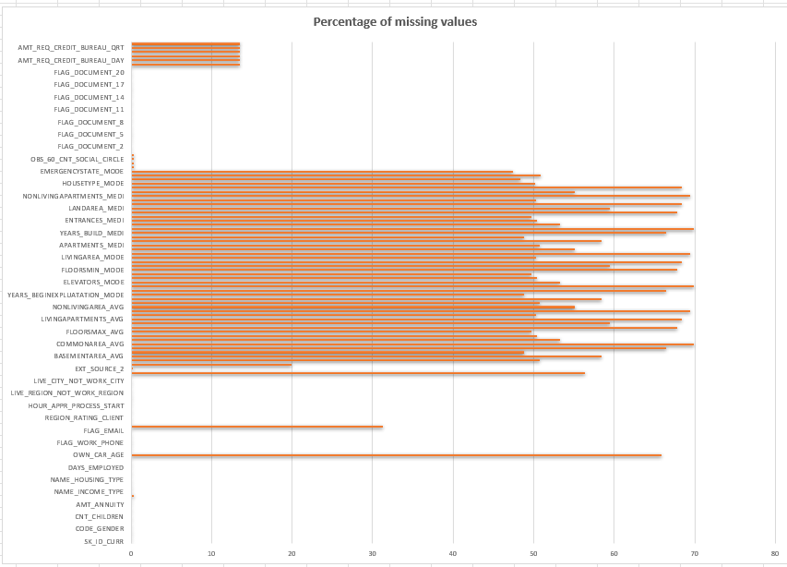

Slide 10
Identify Outliers in the Dataset
Outliers can significantly impact the analysis and distort the results. You need to identify outliers in the loan application dataset.
My Task: Detect and identify outliers in the dataset using Excel statistical functions and features, focusing on numerical variables. Create box plots or scatter plots to visualize the distribution of numerical variables and highlight the outliers.
Click here for Excel file

Slide 11
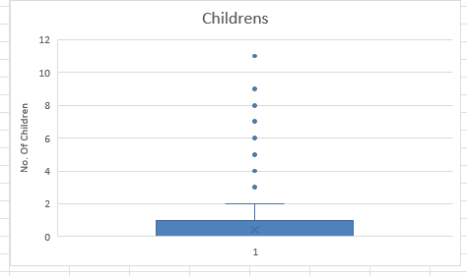
Childrens: The majority of applicants have a small number of children, mostly ranging from 0 to 2. There are a few applicants with more children, which are considered outliers. This could be due to larger families or anomalies in data entry. Understanding these outliers helps design loan products that cater to the specific needs of larger families.

Slide 12
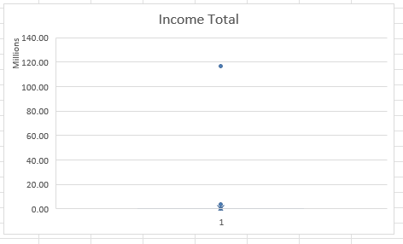
Income Total: The Income Total plot shows a outlier with an extremely high income. Most applicants have incomes clustered towards the lower end, with a median value much lower than the outlier. This outlier could represent a high-income individual or an error in data recording. Understanding this distribution can help tailor financial products and assess borrower risk.

Slide 13
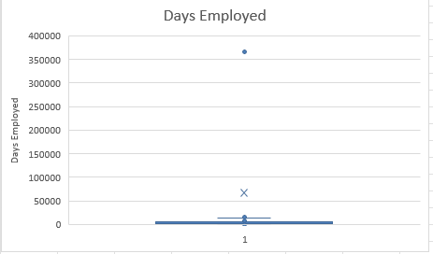
Days Employed: The Days Employed plot indicates a outlier with an unusually high number of days employed. The majority of the data points are clustered around the lower end, indicating shorter employment durations. This outlier might be due to a data entry error. Recognizing these outliers informs risk assessment and enables tailored loan products for long-tenured employees.

Slide 14
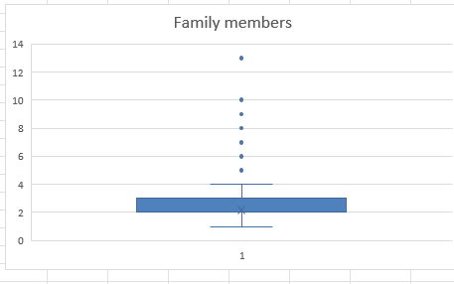
Family Members: Most applicants have between 1 and 4 family members, with a few outliers having larger families. These outliers may represent multi-generational household or joint families. Recognizing these outliers allows for tailored loan offerings that consider the financial situation of larger households.

Slide 15
Analyze Data Imbalance
Data imbalance can affect the accuracy of the analysis, especially for binary classification problems. Understanding the data distribution is crucial for building reliable models.
My Task: Determine if there is data imbalance in the loan application dataset and calculate the ratio of data imbalance using Excel functions. Create a pie chart or bar chart to visualize the distribution of the target variable and highlight the class imbalance.
Click here for Excel file

Slide 16
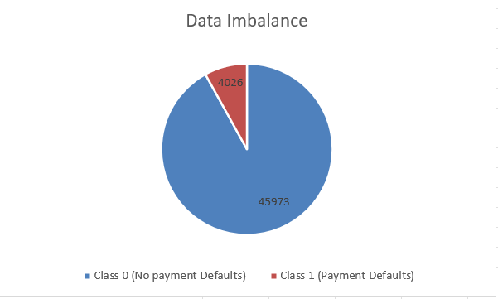
The pie chart “Data Imbalance” shows a significant imbalance between two classes in the dataset with a ratio of approximately 11:1 between non-defaulters and defaulters.
Class 0 (No payment Defaults): This class represents the majority of the data, with 45,973 instances.
Class 1 (Payment Defaults): This class is much smaller, with only 4,026 instances.
This imbalance indicates that most customers do not default on their payments, while a smaller number of customers does.

Slide 17
Univariate, Segmented Univariate, and Bivariate Analysis
To gain insights into the driving factors of loan default, it is important to conduct various analyses on consumer and loan attributes.
My Task: Perform univariate analysis to understand the distribution of individual variables, segmented univariate analysis to compare variable distributions for different scenarios, and bivariate analysis to explore relationships between variables and the target variable using Excel functions and features.
Click here for Excel file

Slide 18
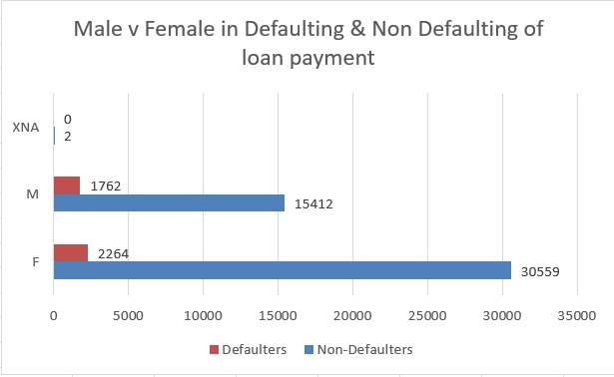
Higher Participation of Females in Loans: Females represent a significantly larger share of loan applicants compared to males.
Lower Default Rate for Females: Despite having more loans, females have a lower default rate than males.
Minimal Data for XNA: The XNA category has minimal participation and no defaults, suggesting it might be an insignificant or incorrectly recorded category.

Slide 19
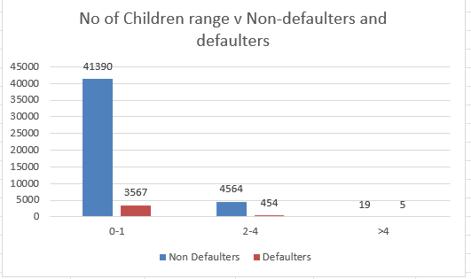
Higher Loan Participation with Fewer Children: Most loans are taken by those with 0-1 children, who also have a relatively lower default rate.
Increased Default Risk with More Children: The data shows that the likelihood of defaulting increases with the number of children, especially in the >4 category, indicating a potential risk factor.

Slide 20
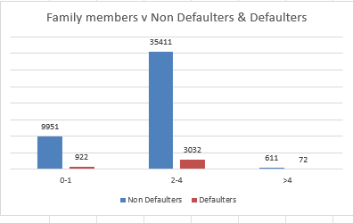
The highest number of loans taken by families with 2-4 members corresponds to the highest number of non-defaulters and defaulters in this group.
Despite taking fewer loans, families with more than 4 members have the highest defaulter rate, indicating potential financial stress or other factors influencing their ability to repay loans.
Families with 0-1 members have a moderate number of loans with a slightly higher defaulter rate than families with 2-4 members, suggesting that smaller families might also face challenges in loan repayment.

Slide 21
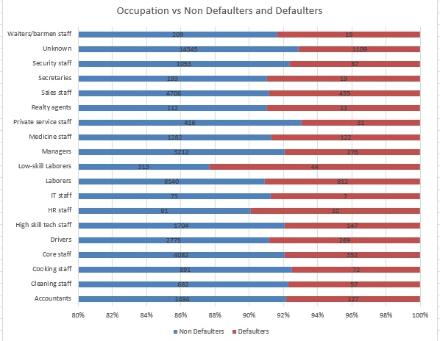
The occupation categories with a high number of loans taken, such as "Unknown," Laborers, and Core staff, tend to have higher absolute numbers of both non-defaulters and defaulters, indicating a larger sample size rather than inherently higher risk.
Occupations, like Managers, Medicine staff, and High skill tech staff, although having a significant number of loans, maintain relatively low defaulter rates, suggesting these occupations might be more financially stable or have better access to resources to repay loans.
Occupations like Drivers and Security staff, which have a high number of loans and moderate defaulter rates, might require additional financial knowledge or support programs to reduce default rates.

Slide 22
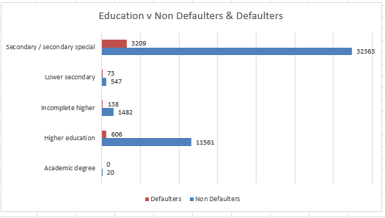
Individuals with higher education and academic degrees show lower default rates, suggesting better financial stability and possibly better access to resources for loan repayment.
The high defaulter rate among those with lower secondary education indicates a higher financial risk for this group, possibly due to limited earning potential or lack of financial literacy.
The large number of loans taken by those with a Secondary/Secondary special education level, combined with a relatively higher defaulter rate, suggests that this group, while active in seeking loans, also faces significant repayment challenges.

Slide 23
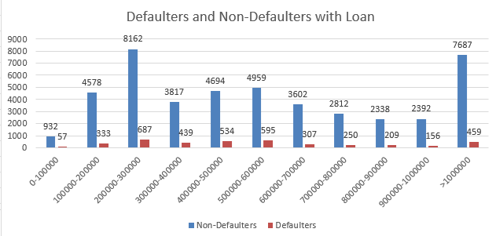
Segmented Univariate Analysis
The lower credit ranges, specifically 0-100,000 and 100,000-200,000, have relatively high default rates compared to the total number of loans in these ranges. For example, in the 0-100,000 range, out of 989 total loans, 57 are defaults, which represents about 5.8% of the total loans in that range.
The majority of loans fall within the 200,000-300,000 range, with 8,849 loans issued. This range also has the highest number of defaulters (687), though the default rate is not the highest proportionally compared to other ranges.
In the credit range above 1,000,000, there are 8,146 loans, with 459 being defaults. This results in a default rate of approximately 5.6%, which is relatively low considering the high number of loans issued. This suggests that borrowers in this higher credit range are more likely to repay their loans compared to those in lower ranges.

Slide 24
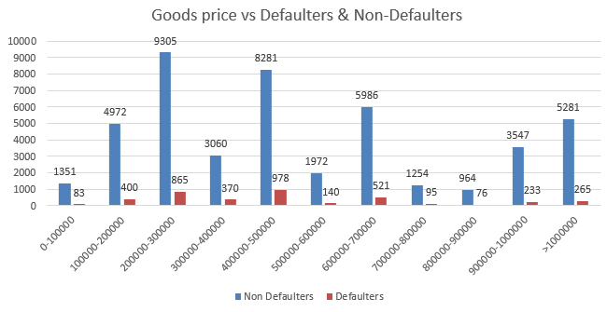
There are significantly more non-defaulters than defaulters across all price ranges of goods. The highest concentration of non-defaulters is in the 200,000-300,000 range, with 9305 non-defaulters.
The number of defaulters remains relatively low across all price ranges compared to non-defaulters. The highest number of defaulters is in the 400,000-500,000 range, with 978 defaulters, which is noticeably higher than in other price ranges.
Despite the highest number of non-defaulters being in the 200,000-300,000 range, the number of defaulters does not show a similar peak, suggesting that higher goods prices do not necessarily correlate with a higher number of defaulters. The total number of transactions both defaulters and non-defaulters is highest in the 200,000-300,000 and 400,000-500,000 ranges, indicating these price ranges are the most common for goods.

Slide 25
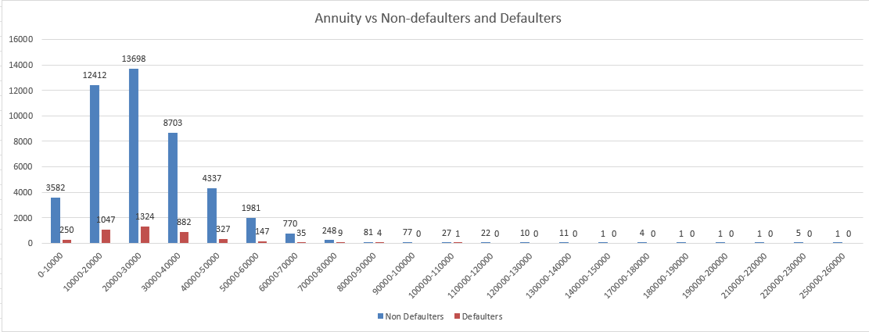
The annuity amounts are heavily concentrated in the lower ranges. The highest number of applicants fall into the 20,000-30,000 range, followed by the 10,000-20,000 and 30,000-40,000 ranges. There are very few applicants with annuity amounts above 100,000, indicating that high annuities are less common.
The 20,000-30,000 annuity range has the highest number of both non-defaulters (13,698) and defaulters (1,324), indicating that this range is the most common among both groups. The defaulter count decreases significantly as the annuity amount increases, especially beyond the 60,000 range, where the numbers drop to single digits or even zero.
Lower annuity ranges (below 50,000) have the highest number of defaulters, suggesting that lower annuity amounts might be associated with a higher risk of defaulting.
As the annuity amount increases, the number of defaulters decreases, indicating that applicants with higher annuities tend to default less frequently.

Slide 26
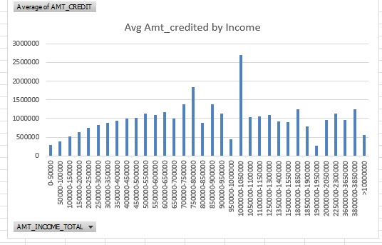
Bivariate Analysis
The average amount credited generally increases with higher income ranges up to a certain point. This trend suggests that individuals with higher incomes are likely to receive higher credit amounts, possibly due to their perceived ability to repay larger loans.
There is a notable spike in the average credit amount for the income range of 1,000,001-1,050,000, where the average credit amount jumps to over 2,500,000. This is an anomaly compared to the surrounding income ranges, indicating that individuals in this specific income range received significantly higher credits. This could be due to special circumstances, outliers, or specific loan products available to this group.
Beyond the 1,000,001-1,050,000 income range, there are fluctuations in the average credit amounts without a clear increasing or decreasing trend. This variability suggests that factors other than income might play a significant role in determining credit amounts at these higher income levels, such as creditworthiness, collateral, or specific financial products tailored to high-income individuals.

Slide 27
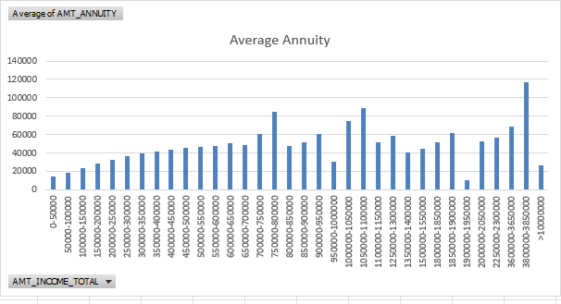
There is a general trend where the average annuity amount increases as the income range increases, indicating that higher-income individuals tend to have higher annuity payments.
Certain income ranges, such as 750,000-800,000, 10,50,000-11,00,000, and 38,00,000-38,500,000, show significant peaks in the average annuity values. These peaks suggest that individuals in these specific income brackets have substantially higher annuities compared to neighboring income ranges.
There are also income ranges with unexpectedly low average annuity values, such as 950,000-10,00,000 and 19,00,000-19,50,000. These outliers may indicate specific financial behaviors or circumstances affecting annuity distributions in these income brackets.

Slide 28
Identify Top Correlations for Different Scenarios
Understanding the correlation between variables and the target variable can provide insights into strong indicators of loan default.
My Task: Segment the dataset based on different scenarios (e.g., clients with payment difficulties and all other cases) and identify the top correlations for each segmented data using Excel functions. Create correlation matrices or heatmaps to visualize the correlations between variables within each segment. Highlight the top correlated variables for each scenario using different colors or shading.
Click here for excel file

Slide 29
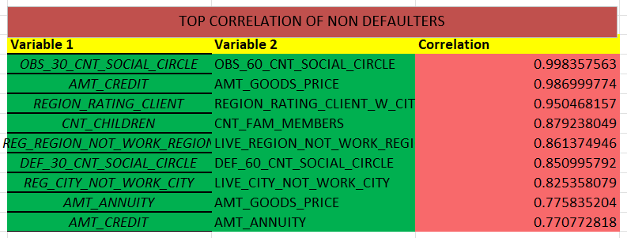
Top correlation for Non Defaulters
The highest correlation (0.998357563) is between OBS_30_CNT_SOCIAL_CIRCLE and OBS_60_CNT_SOCIAL_CIRCLE. This suggests that the count of social circle observations in 30 days and 60 days are highly similar, implying that individuals with many social interactions in the past 30 days tend to have similar counts over 60 days.
AMT_CREDIT and AMT_GOODS_PRICE have a very high correlation (0.986999774), indicating that the amount of credit is closely related to the price of goods. This is logical as higher-priced goods typically require more credit.
REGION_RATING_CLIENT and REGION_RATING_CLIENT_W_CITY show a high correlation (0.950468157), indicating that the overall region rating and the client's city rating within that region are closely aligned.

Slide 30
REG_REGION_NOT_WORK_REGION and LIVE_REGION_NOT_WORK_REGION have a strong correlation (0.861374946). This suggests that individuals who do not work in their registered region also tend to not live in their work region.
The correlation between DEF_30_CNT_SOCIAL_CIRCLE and DEF_60_CNT_SOCIAL_CIRCLE (0.850995792) implies that the number of defaults in the social circle within 30 days is highly related to the defaults within 60 days.
CNT_CHILDREN and CNT_FAM_MEMBERS have a high correlation (0.879238049), indicating that the number of children strongly influences the total number of family members.
There is a notable correlation between AMT_CREDIT and AMT_ANNUITY (0.770772818), suggesting that the credit amount affects the annuity amount.
The correlation between AMT_ANNUITY and AMT_GOODS_PRICE (0.775835204) indicates a connection between the annuity amount and the price of goods.
REG_CITY_NOT_WORK_CITY and LIVE_CITY_NOT_WORK_CITY have a high correlation (0.825358079), showing that individuals who are registered in a city different from their work city often also live in a different city from their work city.

Slide 31
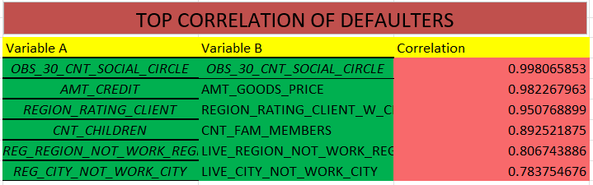
Top correlation for Defaulters
The highest correlation (0.998065853) is between OBS_30_CNT_SOCIAL_CIRCLE and OBS_30_CNT_SOCIAL_CIRCLE.
AMT_CREDIT and AMT_GOODS_PRICE have a very high correlation (0.982267963), indicating that the amount of credit is closely related to the price of goods for defaulters too.
REGION_RATING_CLIENT and REGION_RATING_CLIENT_W_CITY show a high correlation (0.950768899), indicating that the overall region rating and the client's city rating within that region are closely aligned for defaulters.

Slide 32
REG_REGION_NOT_WORK_REGION and LIVE_REGION_NOT_WORK_REGION have a strong correlation (0.806743886). This suggests that individuals who do not work in their registered region also tend to not live in their work region, although the correlation is slightly lower than for non-defaulters.
Unlike non-defaulters, there is no explicit correlation mentioned between DEF_30_CNT_SOCIAL_CIRCLE and DEF_60_CNT_SOCIAL_CIRCLE for defaulters in the provided table. However, the observation counts in the social circle within 30 days (OBS_30_CNT_SOCIAL_CIRCLE) remains highly correlated with the 60-day count.
CNT_CHILDREN and CNT_FAM_MEMBERS have a high correlation (0.89251875), similar to non-defaulters. This suggests that the number of children strongly influences the total number of family members for defaulters too.
REG_CITY_NOT_WORK_CITY and LIVE_CITY_NOT_WORK_CITY have a high correlation (0.783754676), showing that individuals who are registered in a city different from their work city often also live in a different city from their work city. This correlation is slightly lower for defaulters compared to non-defaulters.

Slide 33
Conclusion
Identification of Key Risk Factors: Successfully identified and analyzed key factors that contribute to loan defaults, such as the number of children, family size, total income, and employment duration. This enables a better understanding of what drives defaults and helps in predicting potential risks more accurately.
Data Cleaning and Handling: Managed missing data effectively using techniques like median and mode imputation, ensuring the dataset's integrity and reliability. This was crucial for accurate analysis and helped in maintaining the quality of insights derived from the data.
Outlier Detection and Analysis: Identified and analyzed outliers in various variables, which helped in understanding extreme cases that could skew the results. This analysis provided insights into unusual data points, aiding in creating more robust and accurate predictive models.
Addressing Data Imbalance: Analyzed the significant class imbalance between non-defaulters and defaulters. Understanding this imbalance is essential for developing models that are not biased towards the majority class and can accurately predict defaults.
Correlation and Relationship Insights: Conducted comprehensive univariate, segmented univariate, and bivariate analyses to uncover relationships between variables and their impact on loan defaults. Identified strong correlations that provide deeper insights into the factors influencing loan repayment behavior.

Slide 34
Result
Enhanced Risk Assessment: The project enhanced the understanding of which factors significantly impact loan default risks, allowing for more accurate risk assessment and better decision-making in the loan approval process.
Improved Data Handling Skills: Gained proficiency in handling and cleaning large datasets, which is a crucial skill for any data analysis project. This included learning to deal with missing data and outliers effectively.
Analytical and Visualization Techniques: Developed and applied various analytical techniques using Excel, such as correlation analysis, outlier detection, and data visualization. These techniques are valuable for presenting data insights clearly and effectively.
Understanding of Data Imbalance Impact: Learned the importance of addressing data imbalance in predictive modeling. This understanding is crucial for building models that can generalize well to both majority and minority classes in the dataset.
Insightful Reporting: The project reinforced the importance of reporting and presenting data findings in a clear, concise manner. Creating visualizations and summarizing insights helped in communicating the analysis results effectively to stakeholders.

